Slide 1
Hough, corners, feature points CS B657 Spring 2017

Slide 2
Announcements
Assignment #1 posted
Important: Bring a laptop to class on Wednesday, if possible!

Slide 3
Hough Transform
Basic idea: Every pixel casts a vote for all of the lines that could have generated it
Tabulate votes to find most likely line(s)
Voting is conducted in a parameter space
For lines, we could parameterize in terms of slope and y-intercept, i.e. y=mx+b
y
b
which lines intercept this point?
x
m

Slide 4
Hough Transform
Basic idea: Every pixel casts a vote for all of the lines that could have generated it
Tabulate votes to find most likely line(s)
Voting is conducted in a parameter space
For lines, we could parameterize in terms of slope and y-intercept, i.e. y=mx+b
y
b
x
m

Slide 5
Hough Transform
Basic idea: Every pixel casts a vote for all of the lines that could have generated it
Tabulate votes to find most likely line(s)
Voting is conducted in a parameter space
For lines, we could parameterize in terms of slope and y-intercept, i.e. y=mx+b
Intersection point gives
parameters of best fit line
y
b
x
m

Slide 6

Better parameterization
A better parameterization is to use polar coordinates, to avoid unbounded slope (m)
Equation of a line is then
A point in image space corresponds with a _____ in Hough space
y
ρ
x
θ

Slide 7
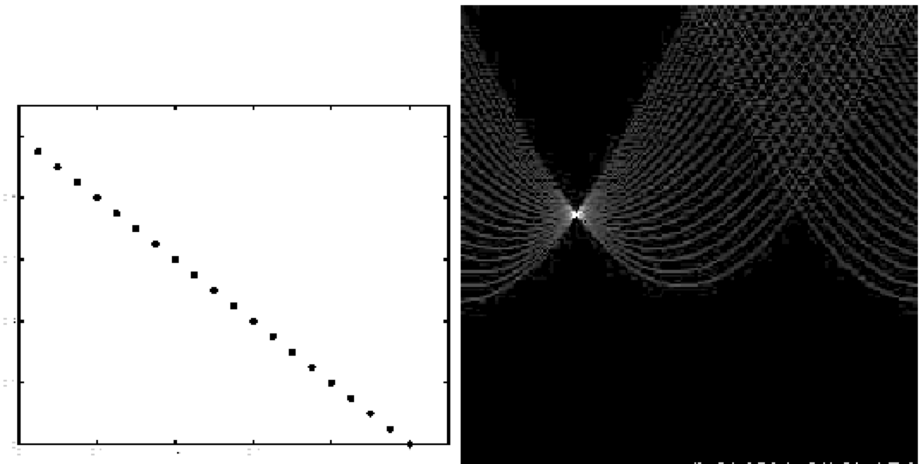
In practice, both image space and Hough space are discretized…
ρ
Image space
θ
Hough space
Notes:
Figure 15.1, top half. Note that most points in the vote array are very dark, because they
get only one vote.

Slide 8
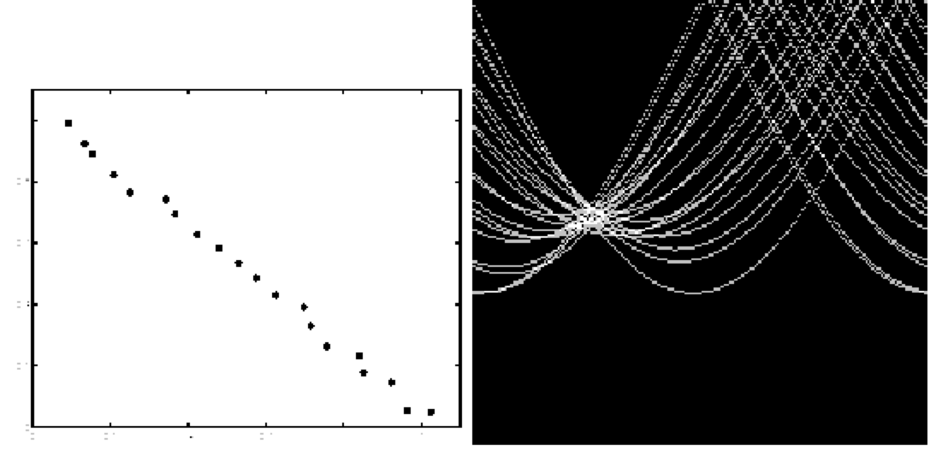
ρ
Image space
θ
Hough space
Notes:
This is 15.1 lower half

Slide 9
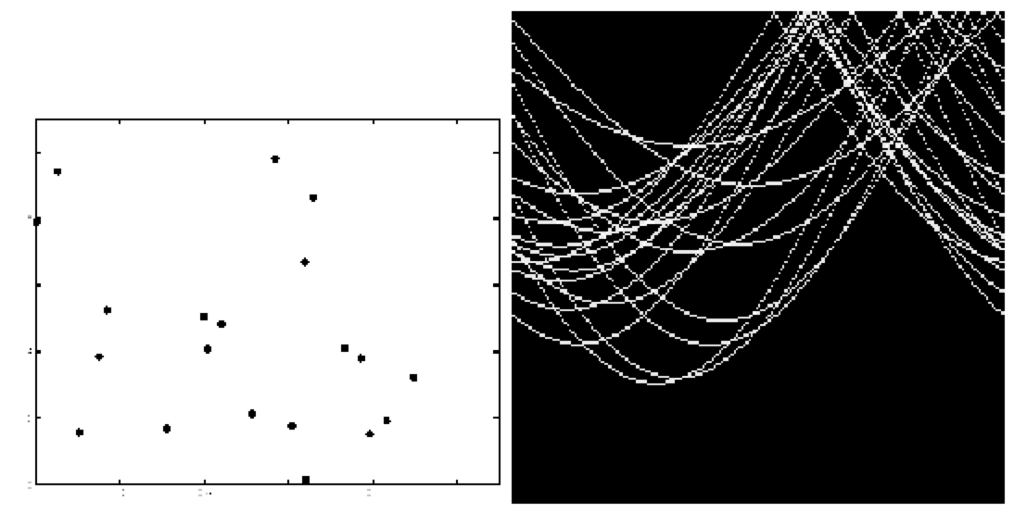
ρ
Image space
θ
Hough space
Notes:
15.2; main point is that lots of noise can lead to large peaks in the array

Slide 10
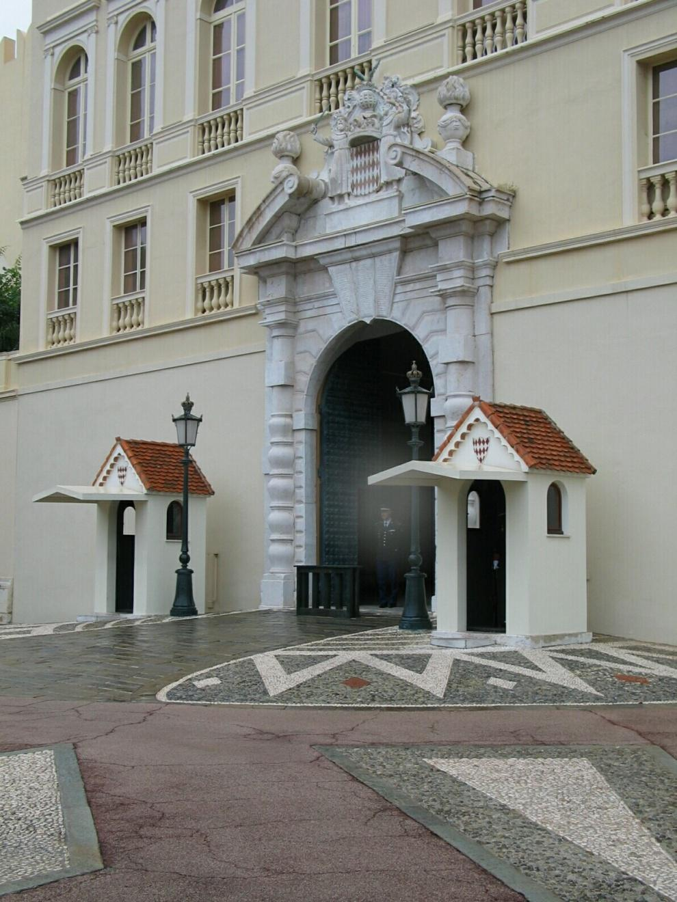
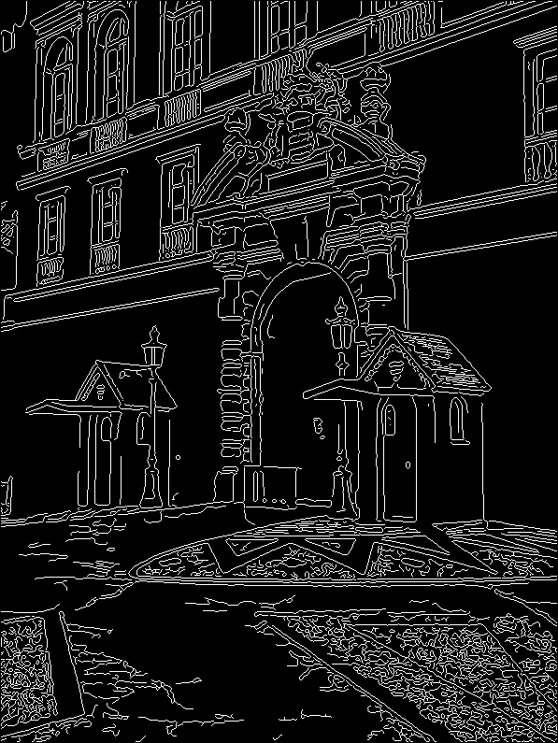
1. Image → Canny

Slide 11
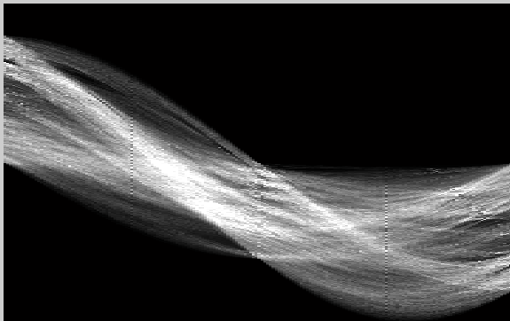
2. Canny → Hough votes

Slide 12
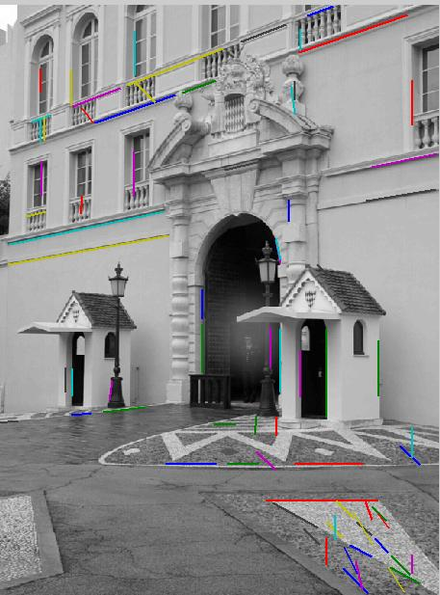
3. Hough votes → Edges
Find peaks and post-process

Slide 13
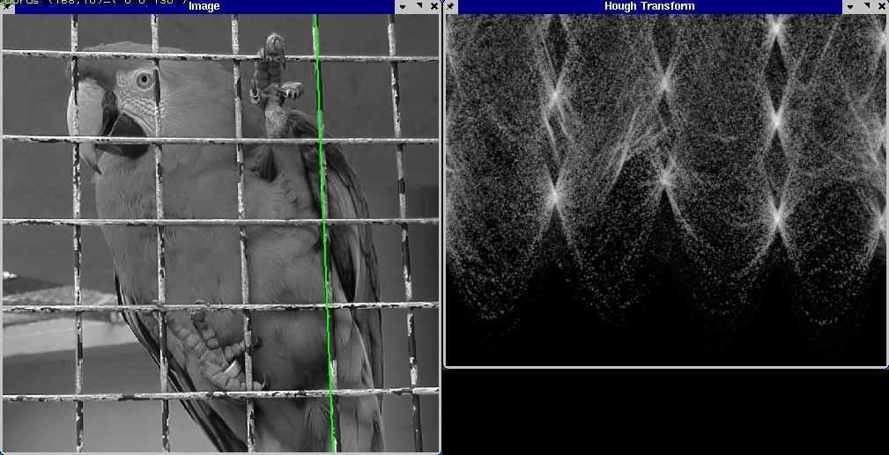
Hough transform examples
http://ostatic.com/files/images/ss_hough.jpg

Slide 14
Practical issues
How to discretize the Hough space?
If cells are too big, lines are merged together; if too small, noise causes lines to be missed
How many lines?
Threshold peaks in the Hough array
Treat adjacent peaks as a single peak (non-maximal suppression)
Which points belong to each line?
Search for points close to the line

Slide 15
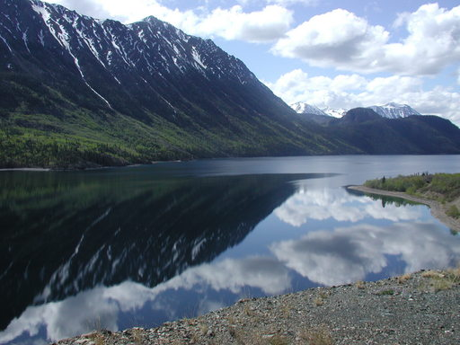
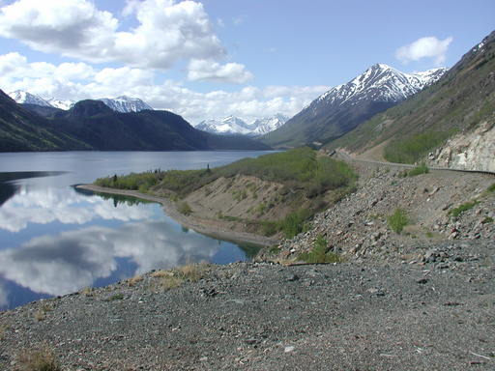
Example: How can we align two pictures?

Slide 16
Example: How can we align two pictures?

Slide 17
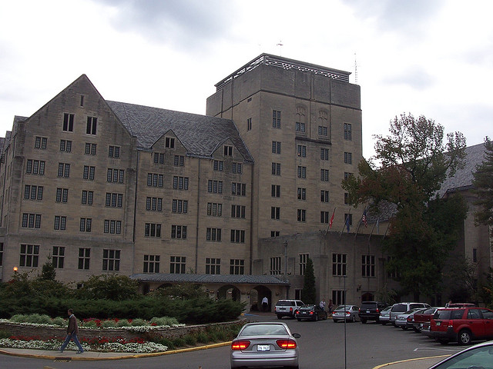
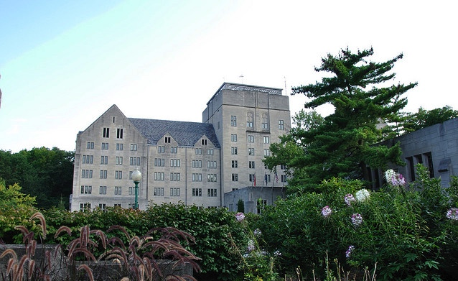

Slide 18
Converting to grayscale gives invariance to color

Slide 19
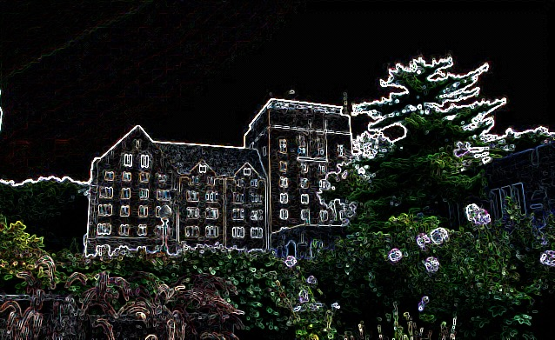
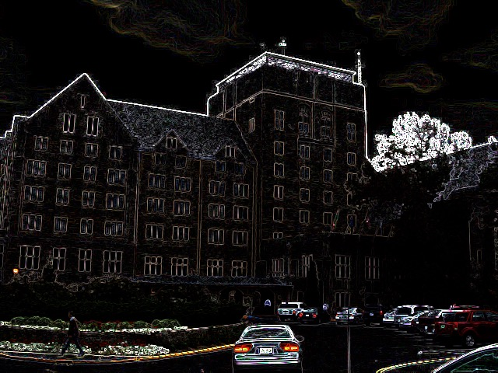
Edge detection gives invariance to illumination changes

Slide 20
But images still won't match up.

Slide 21
(and not just a matter of rescaling)

Slide 22
(or rescaling plus rotation)

Slide 23


How can we align two pictures?
What if:
Not just translation change, but rotation and scale?
Only small pieces of the pictures match?

Slide 24


Interest points (aka Keypoints)
1. Find a set of distinctive key- points
A₁
B₃
2. Define a region around each keypoint
A₂
A₃
B₁
B₂
3. Extract and normalize the region content
4. Compute a local descriptor from the normalized region
5. Match local descriptors

Slide 25
Goals for Keypoints
Detect points that are repeatable and distinctive

Slide 26
Which patches are most distinctive?
?

Slide 27
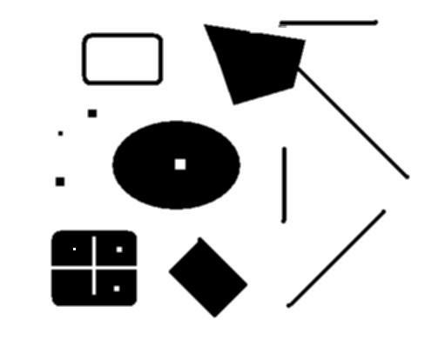
Which points are repeatable?
original
Suppose have to click on some points, then look at a deformed image and click the same points again. Which points would you choose?
deformed

Slide 28
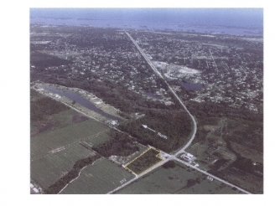
Choosing interest points
Where would you tell your friend to meet you?
Notes:
Corners!

Slide 29
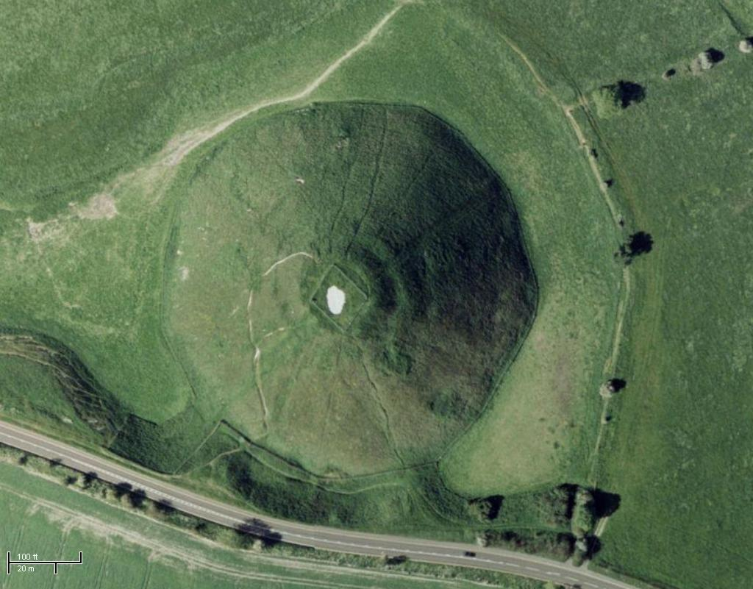
Choosing interest points
Where would you tell your friend to meet you?
Notes:
Blobs!

Slide 30

Choosing interest points
Corners
Peaks/Valleys

Slide 31



Finding corners

Slide 32
Corners
A corner is characterized by a region with intensity change in two different directions
Use local derivative estimates
Gradient oriented in different directions
Not as simple as looking at gradient (partial derivatives) with respect to the image coordinate frame

Slide 33
Corner detection: the basic idea

Slide 34

Corner detection: the basic idea
“flat” region: no change in any directions

Slide 35

Corner detection: the basic idea
“flat” region: no change in all directions
“edge”: no change along the edge direction

Slide 36
Corner detection: the basic idea
“flat” region: no change in all directions
“edge”: no change along the edge direction
“corner”: significant change in all directions

Slide 37

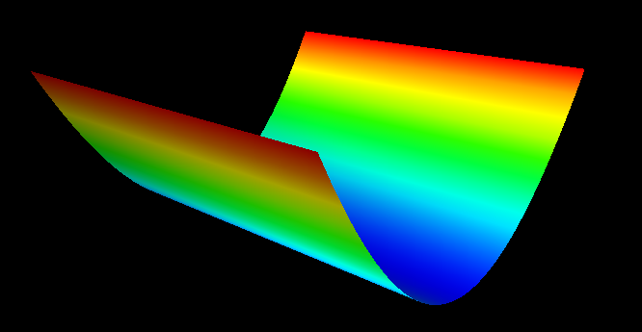
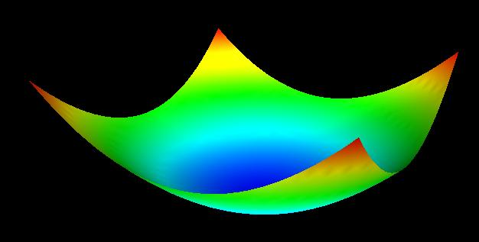
“flat” region: no change in all directions
“edge”: no change along the edge direction
“corner”: significant change in all directions
Imagine plotting a function measuring how much change occurs for any given movement

Slide 38
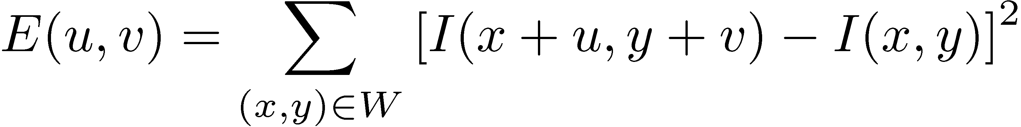
Corner detection: The details
Consider shifting a window W by (u,v)
Measure the change by computing the sum squared difference (SSD) between the new window and old window,
W
(u,v)

Slide 39
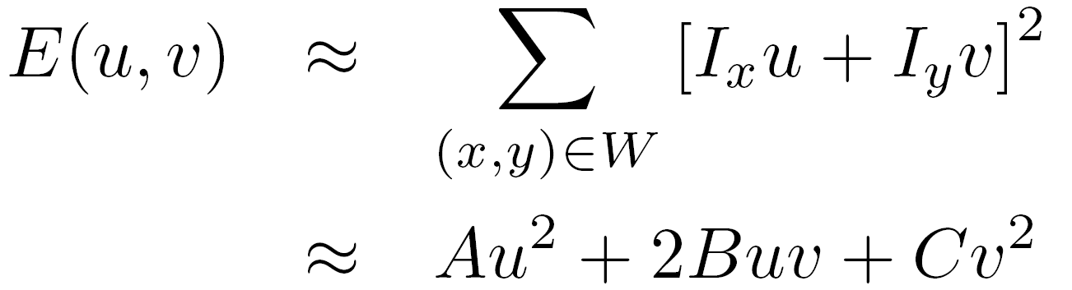
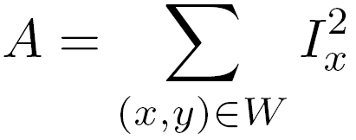
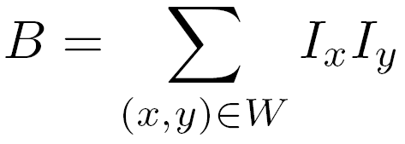
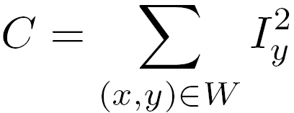
Corner detection: the math
Consider shifting the window W by (u,v)
define an SSD “error” E(u,v):
W

Slide 40

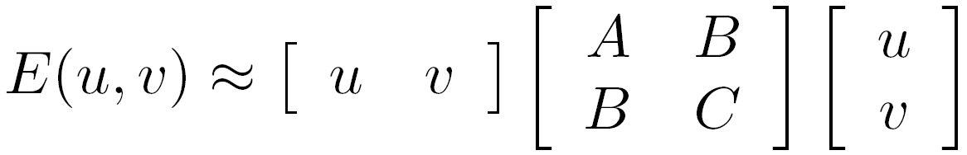

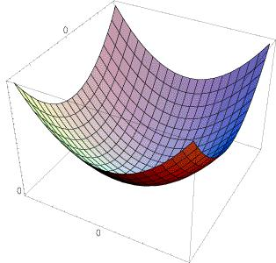
The second moment matrix
The surface E(u,v) is locally approximated by a quadratic form.
Let’s try to understand its shape.

Slide 41
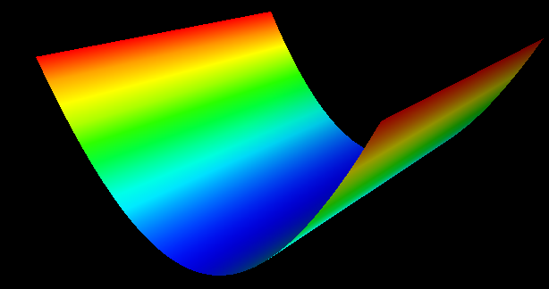


Slide 42


Slide 43
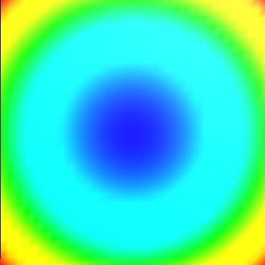

Slide 44
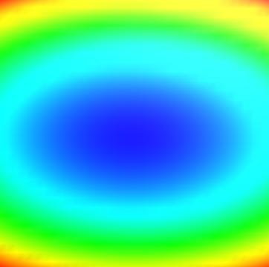
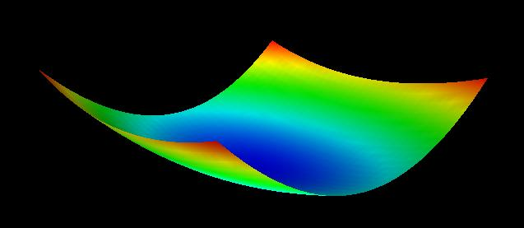

Slide 45
